Slide 1
Project Description:
The objective of this project is to analyze the company's hiring process, salary distribution, departmental composition, and position tiers using Excel.
By exploring various data points such as gender distribution, average salary, salary intervals, departmental representation, and position tiers, the aim is to derive actionable insights that will help the company understand its workforce better and make data-driven decisions.

Slide 2
Approach
The approach to this project involved five key analyses:
Hiring Analysis: The gender distribution of hired employees was calculated using Excel's COUNTIFS function, filtering only those employees who had been hired.
Salary Analysis: The average salary of hired employees was computed using the AVERAGEIFS function, focusing on those who had been hired.Salary
Distribution: The salaries were grouped into class intervals using the FREQUENCY function to visualize the spread of salaries across different ranges.
Departmental Analysis: A pie chart was created to represent the proportion of employees in different departments. The data was processed using the COUNTIFS function.
Position Tier Analysis: The distribution of employees across different job position tiers was analyzed using the COUNTIFS function, and a bar chart was created for visual representation.

Slide 3
Tech-Stack
Tech-Stack Used Software:
Microsoft Excel 2022Purpose: Used to perform data analysis and create visualizations, including pie charts, bar graphs, and salary frequency distribution.
Key Functions: COUNTIFS, AVERAGEIFS, FREQUENCY, and Excel charting tools were used for data calculations and visualizations.

Slide 4
Insights
Key Findings:
The company has hired more males than females. Specifically, 2,563 males have been hired compared to 1,856 females. Additionally, 268 employees chose not to disclose their gender.
Salary Analysis:The average salary of hired employees is $49,752.90, indicating the general pay scale within the company. However, there are significant variations between departments and tiers.Salary
Distribution:The majority of employees (3,853 hires) fall within the $0–$80,640 salary range. This highlights that the company has a large proportion of employees in lower to mid-salary brackets. Only a few employees are in higher salary ranges above $160,480.
Departmental Analysis:The Operations Department employs the largest portion of the workforce, with 1,843 hires, followed by the Service Department with 1,332 employees. Smaller departments, like Human Resources and General Management, have fewer employees, reflecting the organization’s focus on operations and services.
Position Tier Analysis:The analysis shows a concentration of employees in the lower tiers (e.g., c9, c5). Specifically, c9 has the highest number of hires (1,239), followed by c5 (1,182). The higher position tiers have fewer employees, indicating a more pyramid-like structure in the organization’s hierarchy.

Slide 5
Result
Through this analysis, the company gains valuable insights into its hiring patterns, salary distribution, departmental staffing, and hierarchical structure.
These insights can help the company strategize better for future hiring, improve pay equity, and allocate resources effectively across departments.
Furthermore, visual representations through pie charts and bar graphs provide a clearer understanding of workforce composition.

Slide 6
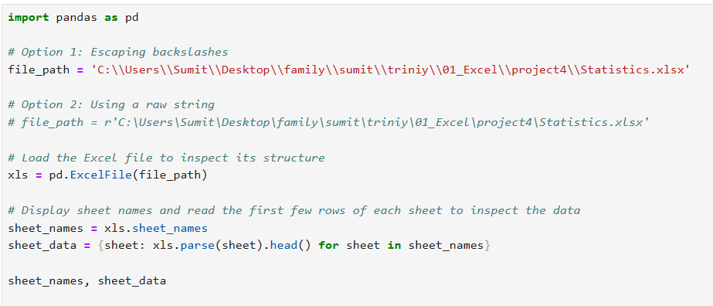
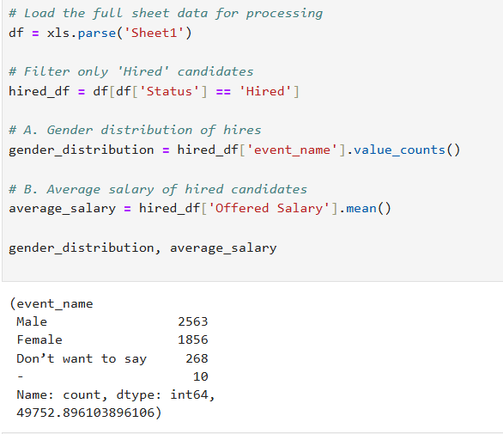

Slide 7
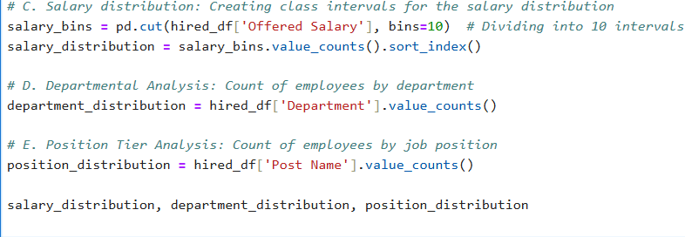
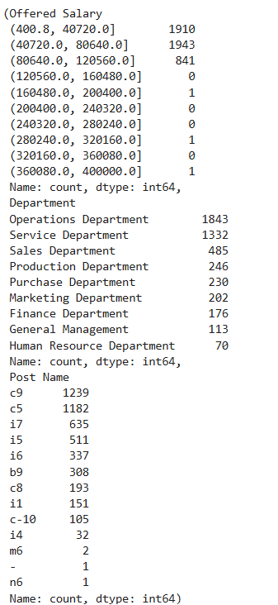

Slide 8
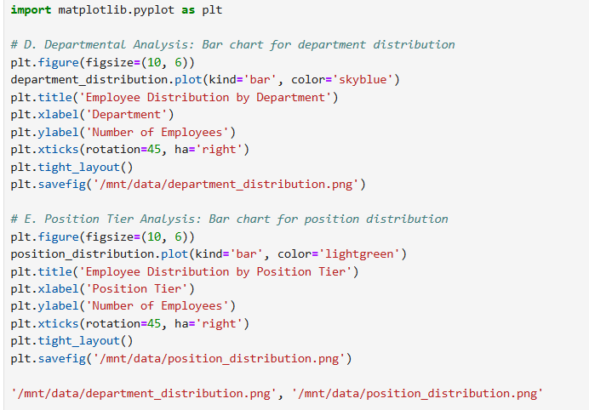

Slide 9
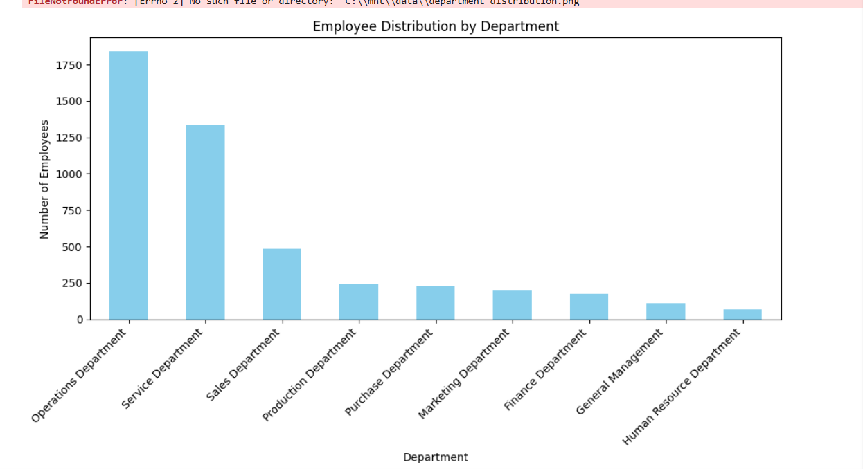

Slide 10
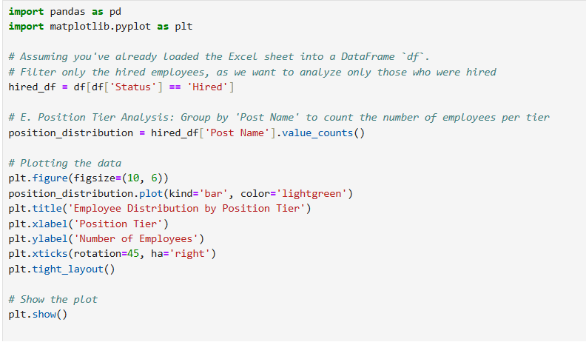

Slide 11
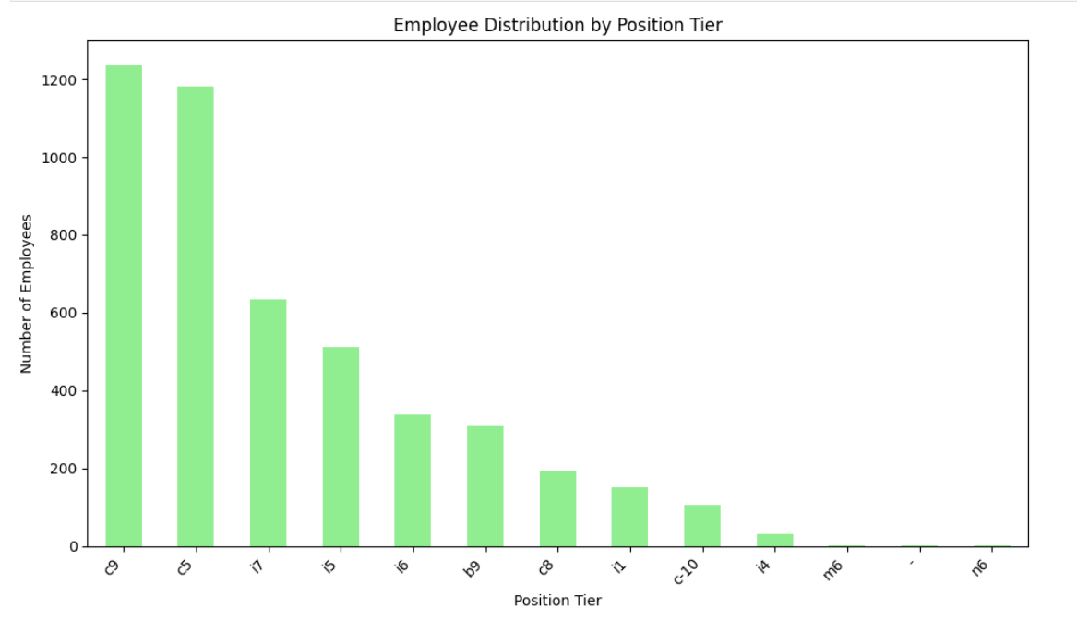

Slide 12
Thank You !

